Slide 1
BT201
Biochemical Process Calculations
25/08/2022

Slide 2
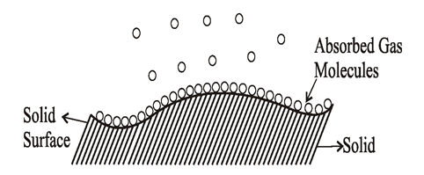
Adsorption (equilibrium solid-fluid)
Attraction of chemical species in gases or liquids to the surface of solids is the basis of ADSORPTION separation processes
Adsorption is a process in which molecules from gas (or liquid) phase land on, interact and attached to solid surface.
Attachment : physical (van de Waal force) or chemical adsorption
Adsorbent: solid surface
Adsorbate: component attracted
to the solid surface
(Adsorbate)
(Adsorbent)
Example:
compressed air dried and purified by passing through a bed of calcium chloride to remove water vapor and then through a bed of activated carbon to separate hydrocarbons for breathing
Recovery of protein and enzymes by adsorption on resin
Drying of transformer oil by silica gel

Slide 3
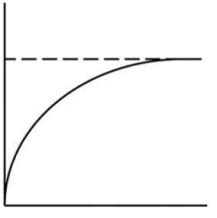



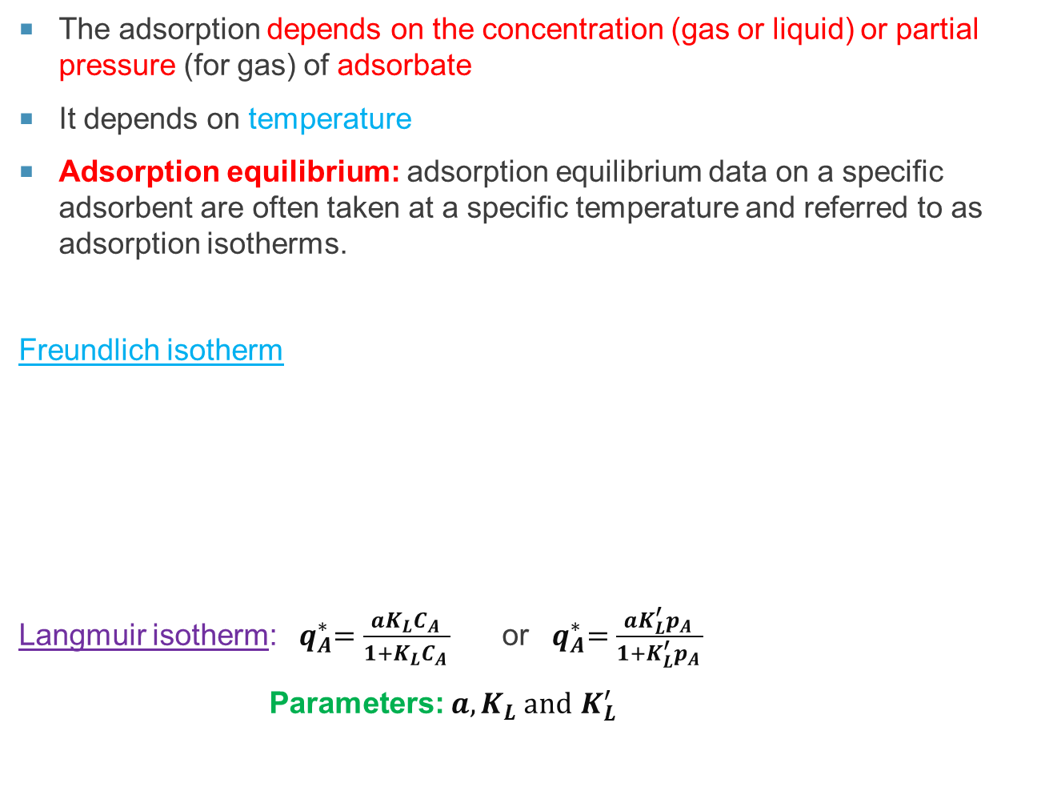
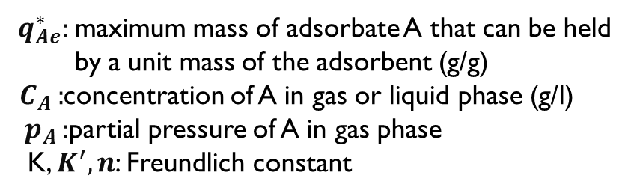
(Adsorbate)
The adsorption depends on the concentration (gas or liquid) or partial pressure (for gas) of adsorbate
It depends on temperature
Adsorption equilibrium: adsorption equilibrium data on a specific adsorbent are often taken at a specific temperature and referred to as adsorption isotherms.
Freundlich isotherm
Langmuir isotherm: ${ q}_{A}^{∗}=\frac{aK_{L}C_{A }}{1+K_{L}C_{A }}$ or ${ q}_{A}^{∗}=\frac{aK_{L}^{′}p_{A }}{1+K_{L}^{′}p_{A }}$
Parameters: $a, K_{L} and$ $K_{L}^{′}$
(Adsorbent)
${ q}_{Ae}^{∗}:$maximum mass of adsorbate A that can be held
by a unit mass of the adsorbent (g/g)
$C_{A }:$concentration of A in gas or liquid phase (g/l)
${ p}_{A }:$partial pressure of A in gas phase
K, $K^{′}, n$: Freundlich constant
${ q}_{Ae}^{∗}={K C}_{Ae}^{1/n}$
${or q}_{Ae}^{∗}={K^{′}p}_{Ae}^{1/n}$
$${ q}_{A}^{∗}$$
$$C_{Ae }$$
Langmuir isotherm

Slide 4
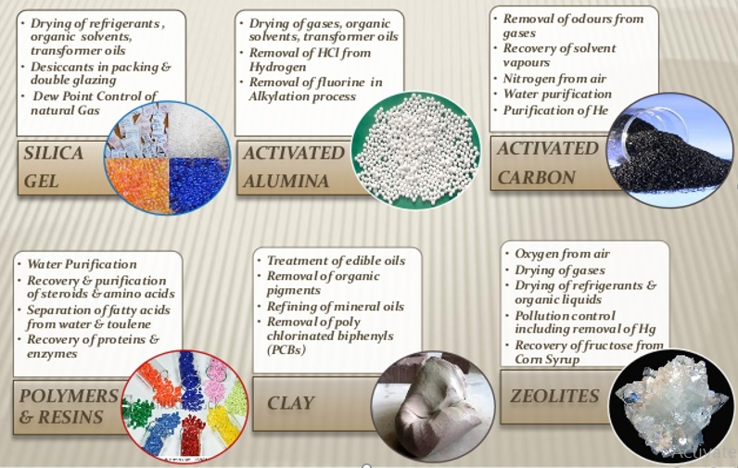
Commercial available adsorbent

Slide 5
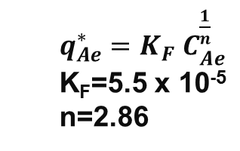
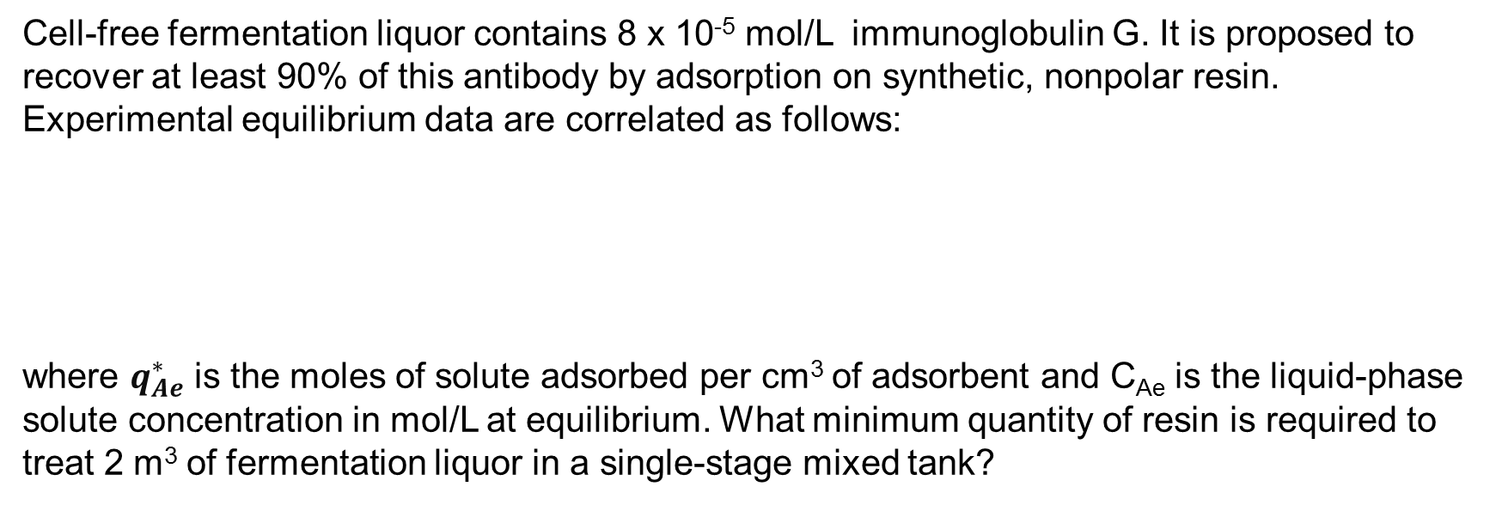
Problem: Adsorption
Cell-free fermentation liquor contains 8 x 10⁻⁵ mol/L immunoglobulin G. It is proposed to
recover at least 90% of this antibody by adsorption on synthetic, nonpolar resin. Experimental equilibrium data are correlated as follows:
where $q_{Ae}^{∗}$ is the moles of solute adsorbed per cm³ of adsorbent and C_{Ae} is the liquid-phase solute concentration in mol/L at equilibrium. What minimum quantity of resin is required to treat 2 m³ of fermentation liquor in a single-stage mixed tank?
$q_{Ae}^{∗}={K_{F} C}_{Ae}^{\frac{1}{n}}$
K_{F}=5.5 x 10⁻⁵
n=2.86

Slide 6
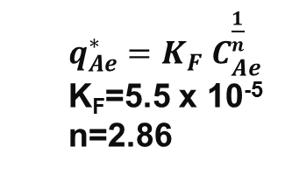
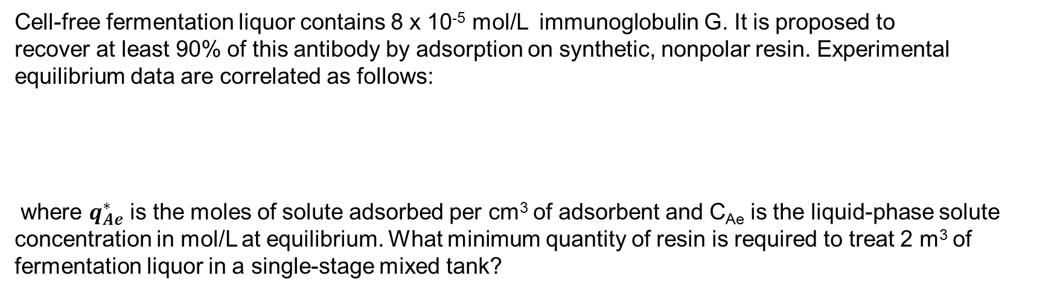
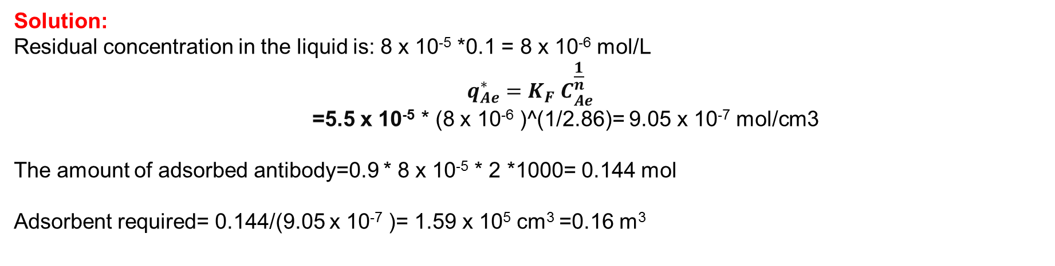
Problem: Adsorption
Cell-free fermentation liquor contains 8 x 10⁻⁵ mol/L immunoglobulin G. It is proposed to
recover at least 90% of this antibody by adsorption on synthetic, nonpolar resin. Experimental equilibrium data are correlated as follows:
where $q_{Ae}^{∗}$ is the moles of solute adsorbed per cm³ of adsorbent and C_{Ae} is the liquid-phase solute concentration in mol/L at equilibrium. What minimum quantity of resin is required to treat 2 m³ of fermentation liquor in a single-stage mixed tank?
$q_{Ae}^{∗}={K_{F} C}_{Ae}^{\frac{1}{n}}$
K_{F}=5.5 x 10⁻⁵
n=2.86
Solution:
Residual concentration in the liquid is: 8 x 10⁻⁵ *0.1 = 8 x 10⁻⁶ mol/L
$$q_{Ae}^{∗}={K_{F} C}_{Ae}^{\frac{1}{n}}$$
=5.5 x 10⁻⁵ * (8 x 10⁻⁶ )^(1/2.86)= 9.05 x 10⁻⁷ mol/cm3
The amount of adsorbed antibody=0.9 * 8 x 10⁻⁵ * 2 *1000= 0.144 mol
Adsorbent required= 0.144/(9.05 x 10⁻⁷ )= 1.59 x 10⁵ cm³ =0.16 m³

Slide 7
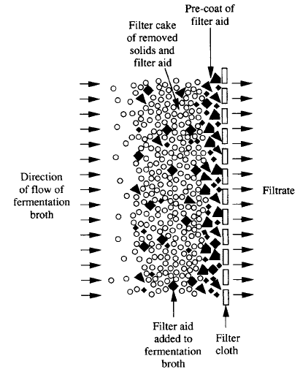
Filtration
In filtration, solid particles are separated from fluid –solid mixture. In this process solid particles suspended in a liquid passes through a porous medium (filter medium or filter cloth) which retains the particles. Most of the liquid passes through the medium (e.g., a filter) to form the filtrate, and the solids are deposited on the filter to form the filter cake.
Filtration can be performed using either vacuum or positive-pressure equipment.
Use in Cell removal: A common first step in product recovery is removal of cells from the fermentation liquor. This is necessary if the biomass itself is the desired product, e.g. bakers' yeast, or if the product is contained within the cells. Removal of cells can also assist recovery of product from the liquid phase. Filtration and centrifugation are typical unit operations for cell removal.

Slide 8
A fermentation slurry containing Streptomyces kanamyceticus cells is filtered using a continuous rotary vacuum filter. 120 kg h⁻¹slurry is fed to the filter; 1 kg slurry contains 60 g cell solids. To improve filtration rates, particles of diatomaceous-earth filter aid are added at a rate of 10 kg h⁻¹. The concentration of kanamycin in the slurry is 0.05% by weight. Liquid filtrate is collected at a rate of 112 kg h⁻¹; the concentration of kanamycin in the filtrate is 0.045% (w/w). Filter cake containing cells and filter aid is continuously removed from the filter cloth.
What percentage of liquid (water) is present in the filter cake?
(b) If the concentration of kanamycin in the filter-cake liquid is the same as in the filtrate, how much kanamycin is adsorbed per kg filter aid? Assume kanamycin is not adsorbed by the cell

Slide 9
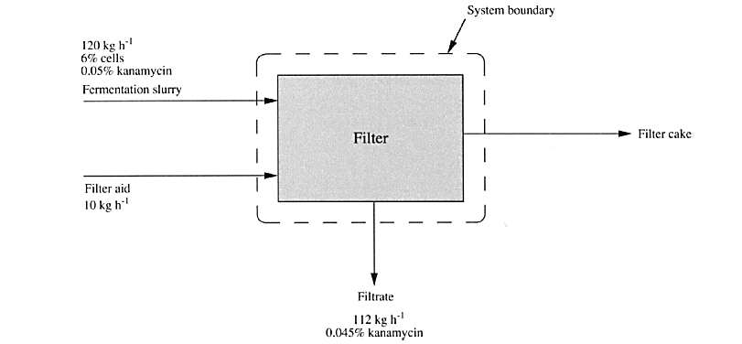

Slide 10

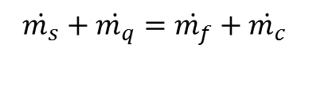


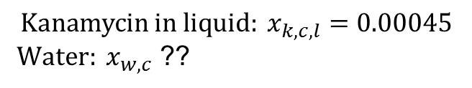
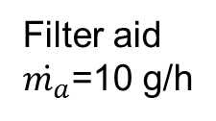








Slurry ($\dot{m_{s}}$): (cell + kanamycin + water)
$\dot{m_{s}}$=120 g/h
Filtrate ($\dot{m_{f}}$): (kanamycin + water)
$${cell: x}_{c,s}=0.06$$
$\dot{m_{f}}$=112 g/h
$${kanamycin: x}_{k,s}=0.0005$$
Kanamycin: 0.045% (w/w)
Filter aid
$\dot{m_{a}}$=10 g/h
$$x_{k,f}=0.00045$$
Filter cake ($\dot{m_{c}}$): (Cell + filter aid + kanamycin + water)
$\dot{m_{c}}$=?? g/h
$${Kanamycin in liquid: x}_{k,c,l}=0.00045$$
${ Water: x}_{w,c}$ ??
Total mass balance
Rate of In=Rate of out
Water mass balance
$$\dot{m_{s}}+\dot{m_{q}}=\dot{m_{f}}+\dot{m_{c}}$$
$$\dot{m_{s}}∗\left(1−{ x}_{c,s}−x_{k,s}\right)+0∗\dot{m_{q}}=\dot{m_{f}}∗(1−0.00045)+\dot{\dot{m_{c}}∗x_{w,c}}$$
$$120+10=112+\dot{m_{c}}$$
$$120∗\left(1−0.06−0.0005\right)=112∗(1−0.00045)+18∗x_{w,c}$$
$$\dot{\dot{m_{c}}=18 kg/h}$$
$$x_{w,c}=0.0439$$
Water in filter cake=4.39%

Slide 11
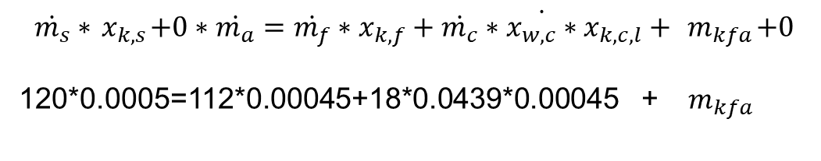
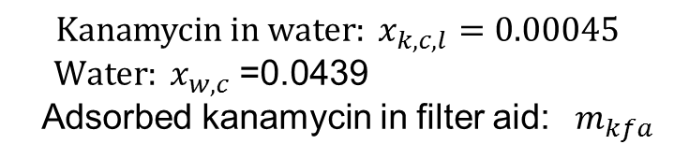


Slurry ($\dot{m_{s}}$): (cell + kanamycin + water)
$\dot{m_{s}}$=120 g/h
Filtrate ($\dot{m_{f}}$): (kanamycin + water)
$${cell: x}_{c,s}=0.06$$
$\dot{m_{f}}$=112 g/h
$${kanamycin: x}_{k,s}=0.0005$$
Kanamycin: 0.045% (w/w)
Filter aid
$\dot{m_{a}}$=10 g/h
$$x_{k,f}=0.00045$$
Filter cake ($\dot{m_{c}}$): (Cell + filter aid + kanamycin + water)
$\dot{m_{c}}$=18 g/h
$${Kanamycin in water: x}_{k,c,l}=0.00045$$
${ Water: x}_{w,c}$ =0.0439
Adsorbed kanamycin in filter aid: ${ m}_{kfa}$
kanamycin mass balance
Adsorbed kanamycin in cell: 0
$$\dot{m_{s}}∗{ x}_{k,s}+0∗\dot{m_{a}}=\dot{m_{f}}∗x_{k,f}+\dot{\dot{m_{c}}∗x_{w,c}∗{ x}_{k,c,l}}+{ m}_{kfa}+0$$
120*0.0005=112*0.00045+18*0.0439*0.00045 + ${ m}_{kfa}$
$${ m}_{kfa}=0.00924$$
Kanamycin is absorbed per kg filter aid=0.00924/10=9.24 x 10⁻⁴ kg/kg

